Slide 1
Module 20

Slide 2

How are such chemicals or hormonal transmission used in animals?
What do some animals, for instance squirrels experience when they are in scary situation?

Slide 3
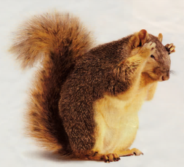
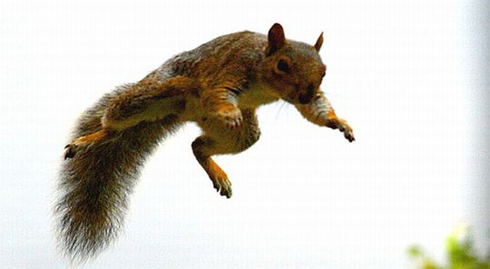
When squirrel experiences a scary situation.
Its body prepare for either fighting
or running away
Both are very complicated activities that will use a great deal of energy.
difficult
Many tissue types will be used and their activities integrated together in these actions.
linked
Two alternate activities fighting or running are quite different.
different
Body should prepare for ideal activity in such cases.
How would this be achieved.

Slide 4
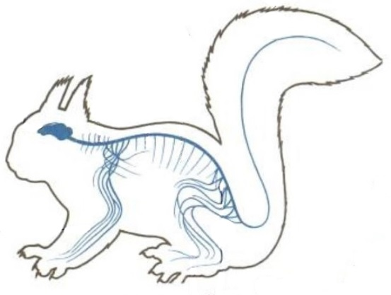
If the body design in the squirrel relied only on electric impulse via nerve cells
depends
Range of tissues instructed to prepare for the coming activity would be limited.

Slide 5
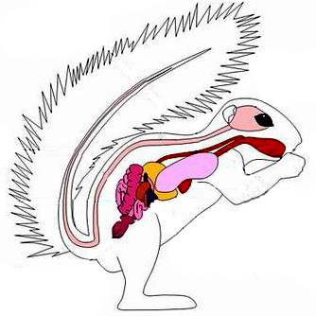
If the body design relied only on chemical impulse via glands.
Range of tissues instructed to prepare for the coming activity would be limited.

Slide 6
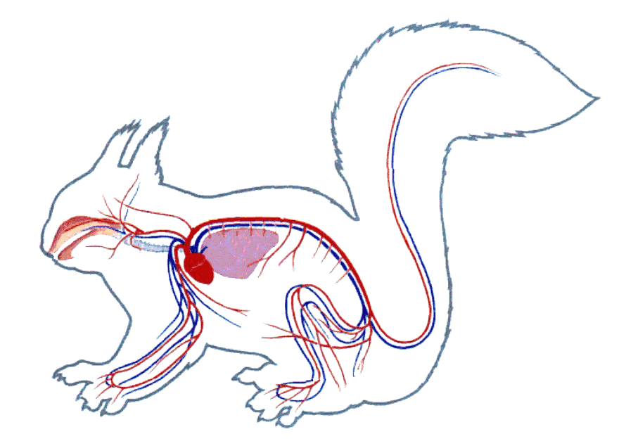
If the body design in the squirrel relied both on electrical and chemical impulse.
Then the signals would reach all cells of the body and provide the wide ranging change needed.
This is done in many animals including human beings.

Slide 7
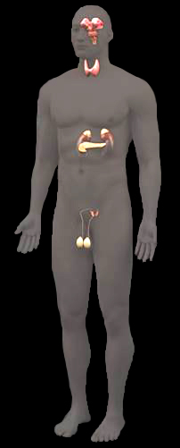
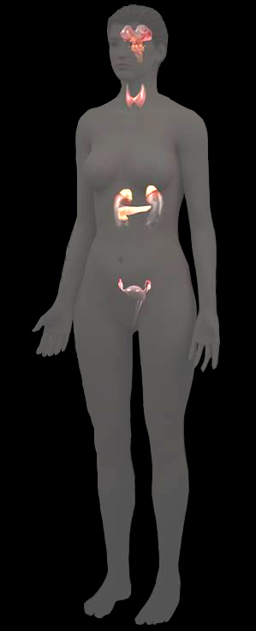
Pituitary glans
Let us see how human uses the hormone called adrenaline that is secreted from the adrenal gland.
Human beings also secrete hormones from glands and achieves the desired results.
Thyroid gland
Adrenal gland
Pancreas
Let us see few endocrine glands of the body.
Ovary
Testis

Slide 8
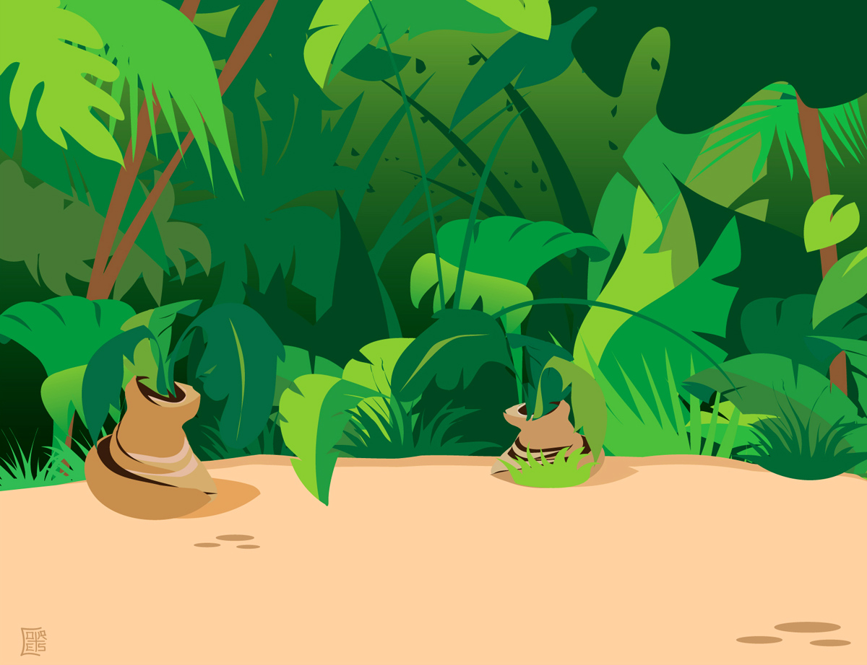
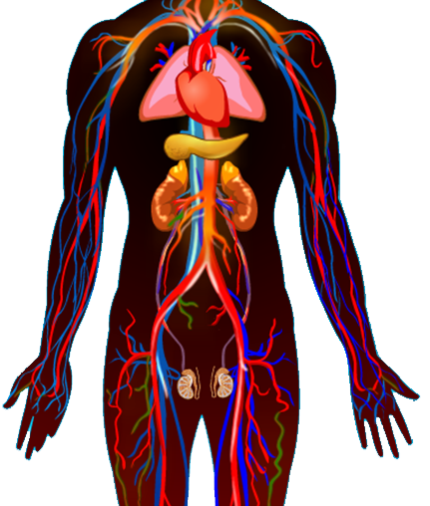
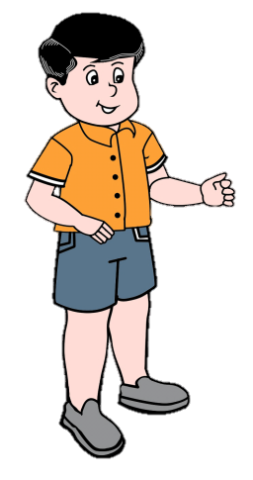
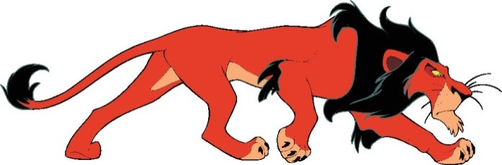
In jungle the boy sees the lion.
Adrenaline is secreted directly into the blood and carried to different parts of the body.
The target organs or the specific tissues on which it acts include the heart.
The heart beats faster,
The blood to the digestive system and skin is reduced due to contraction of muscles.
This diverts the blood to our skeletal muscles.
Breathing rate increases.
All these responses together enable the body to deal with the situation and the boy runs sway.
resulting in supply of more oxygen to our muscles.

Slide 9

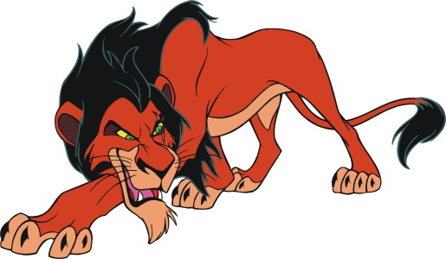

Slide 11
Thank You

